Slide 1

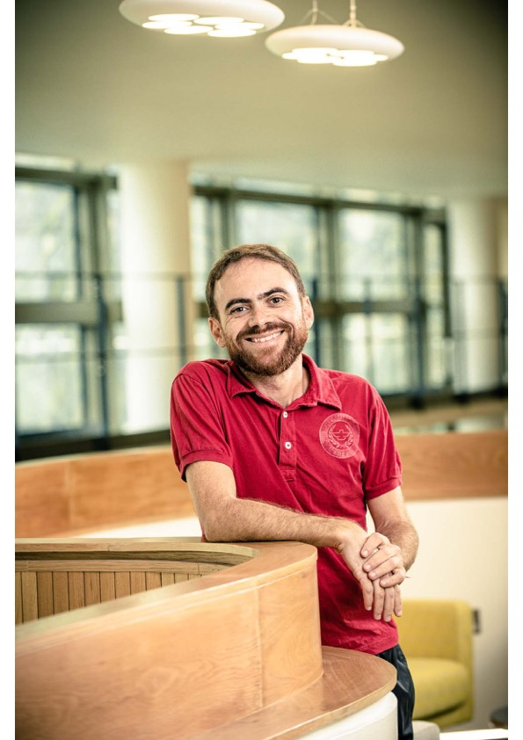

Dependable Medical Devices
– there is no royal road
Leo Freitas
OVT 19, 22/10/2021, Aarhus (Newcastle)
In collaboration with :
Michael Drinan Dialyser (NHS device) lead
Patrick Degenaar Brain pacemaker eng. (NCL) lead
Bill Scott Organ preservation (NHS-BT/Scuba) lead
Notes:
* Mention collaboration process / origin
Mention WMF 2001 first paper (Animating CSPm in Actrion Semantics)
Great to have in the audience my former supervisor(s) + Jim W
Grateful for three of them + CBJ for all the mentoring over the years

Slide 2
Motivation
Most medical device companies are small
CE-marking safety-critical software is tricky:
Regulation and standards only provide guidelines
Engineers are not trained in dependable software techniques
Emphasis on risk control measures
Ad-hoc software engineering methodology (e.g. no language subsets)
How could we transfer skills/methods?
How could we improve dependability before/within clinical trials?
Notes:
lax regulation for what is in effect an area in need of dependable safety critical software
transfer skills from avionics (i.e. technical + regulation (EC62304 + FDA GPSV)…)
lack of well defined software engineering (e.g. MISRA, embedded design patterns, Cleanroom, etc)
there is no software engineer in the loop

Slide 3
Safety and regulation
Premarket review process
Is the product certifiable? Then you can sell the IP
Manufacturers need to demonstrate to a notified body (e.g. BSI):
Medical device is (reasonably) safe prior to market introduction
Engineering evidence (e.g., electrical testing, fire resistance, etc.)
Clinical evaluation (e.g., functionally effective)
Myriad of regulatory documentation
30+ standards to adhere to / address across multiple domains (MHRA, FDA)
Lack of clarity for a pathway to certification; even certifiers are confused!
Software is regulated / classified by IEC62304

Slide 4
Risk analysis for regulatory requirements
Measures taken to ensure that risks associated with the use of the device are as low as reasonably practicable
Measures include careful (i.e. ISO14971) identification of hazards and demonstrations (i.e. field testing) that risks associated with these hazards have been mitigated (i.e. best effort suffice)
Mitigation through adherence to requirements that demonstrate there is a barrier between a hazard and its consequence

Slide 5
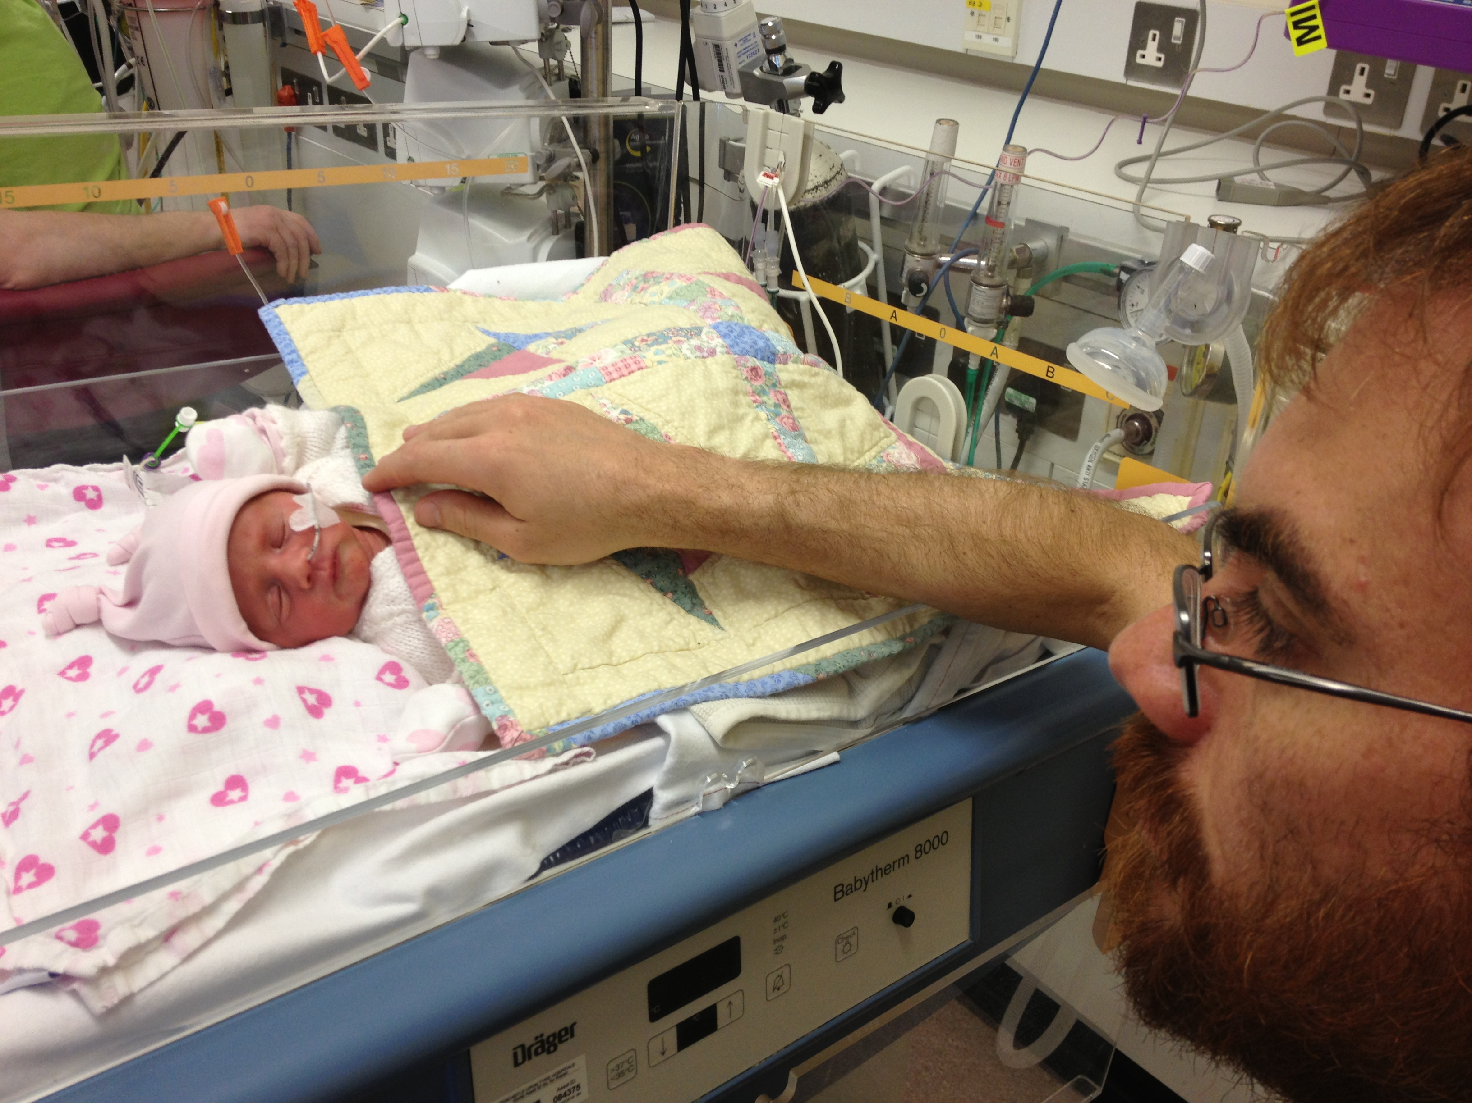
“Personal” experience with devices… (2013)
Notes:
Hospital deaths involving devices, 20% were certainly due to software issues
Harold’s talk about infusion pump I had a direct encounter 2 weeks later
Twice dose before; now half (e.g. change in shift); why is this okay?

Slide 6
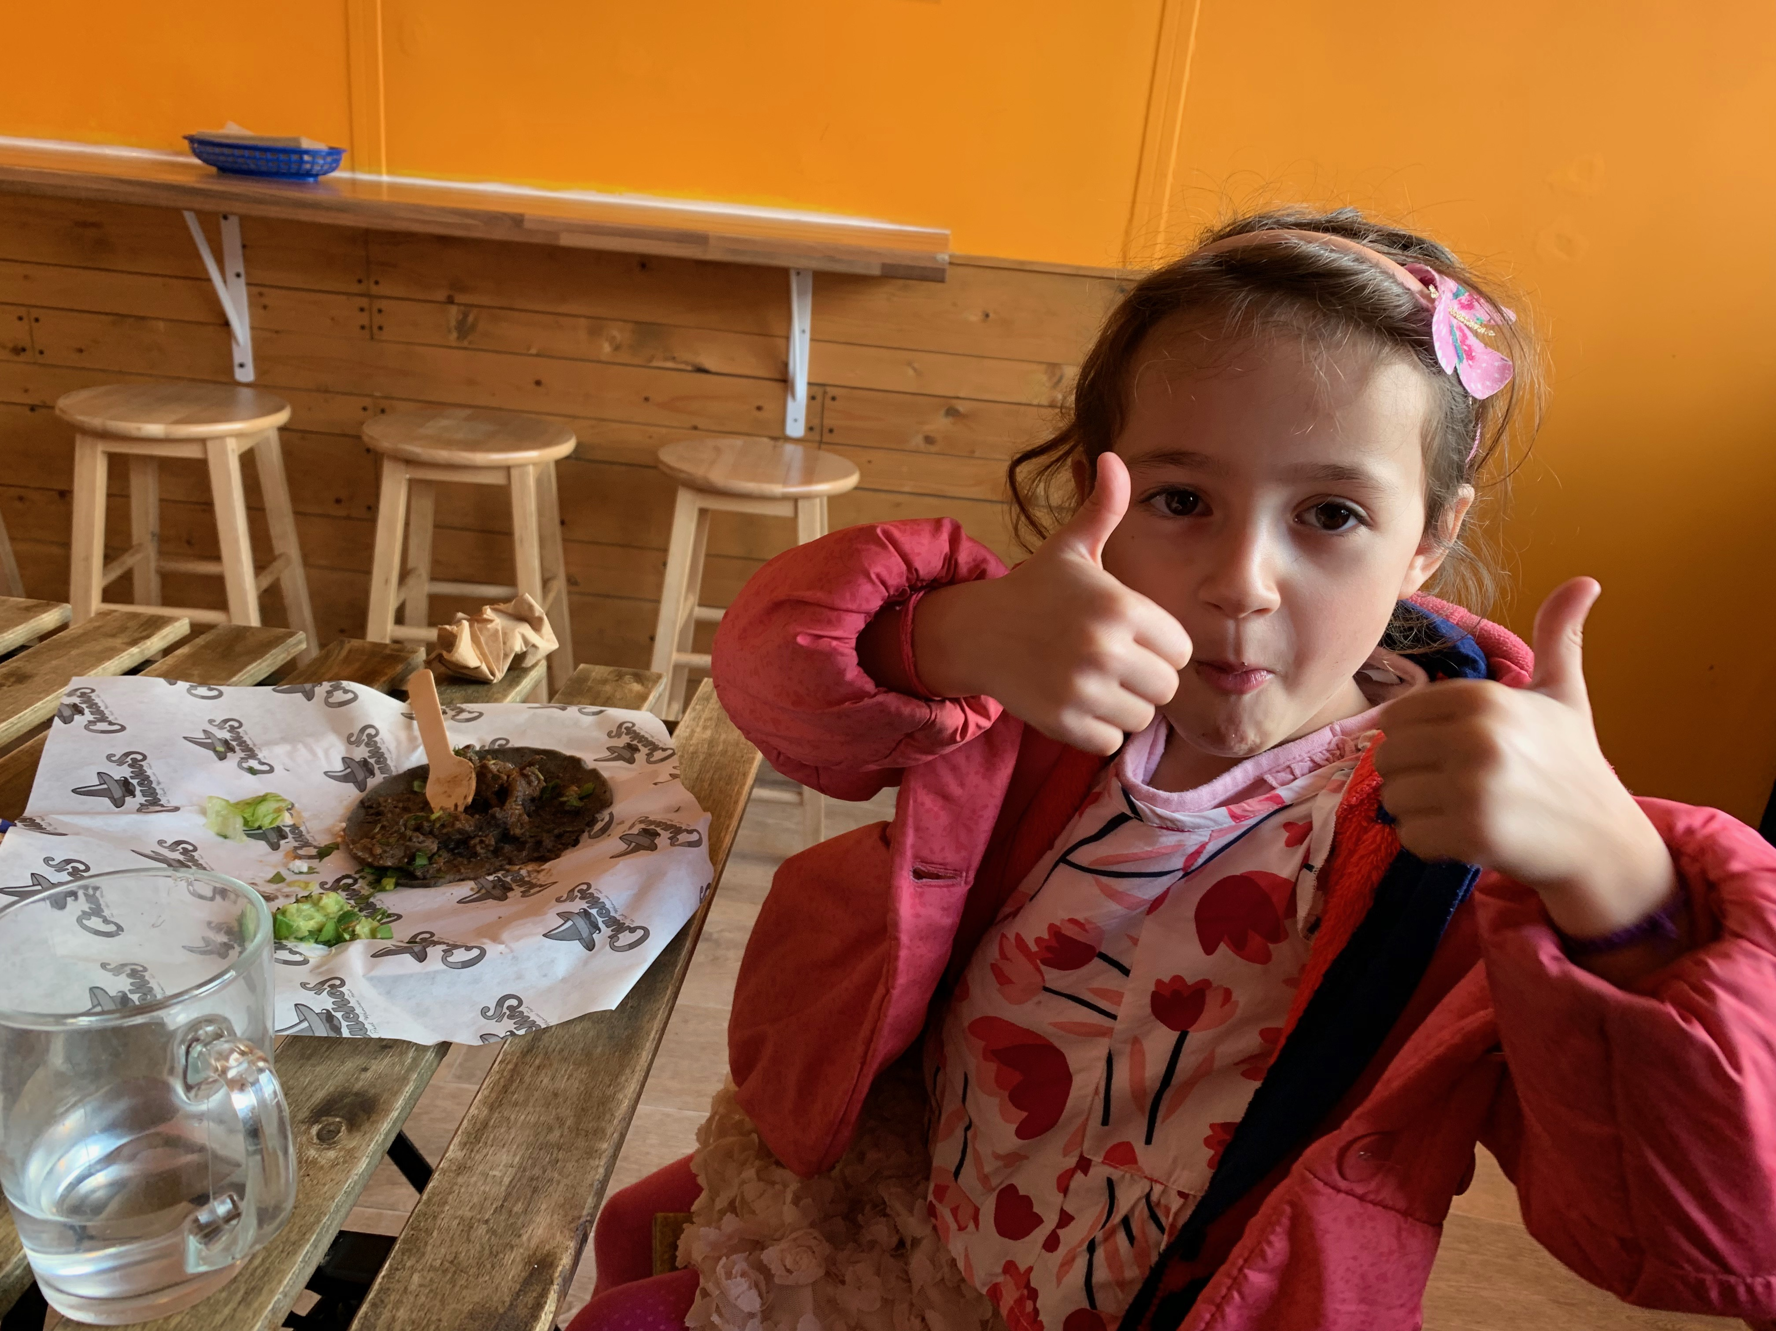
“Personal” experience with devices… (2018)
Notes:
Hospital deaths involving devices, 20% were certainly due to software issues
Harold’s talk about infusion pump I had a direct encounter 2 weeks later
Twice dose before; now half (e.g. change in shift); why is this okay?

Slide 7
Methodology
Application of model based techniques to medical device certification
Model-based formalisms for the design (i.e. FSM + properties)
Code-level verification for C/C++ (partial/total correctness)
Link solutions to regulatory process is crucial
Have a direct link with risk/hazard profile
Ensures stakeholder and regulator care about the formal result
Enables clear demonstration of what the approach can achieve
Choices are dependent on
Openness of designers + time availability + when FM use started
Socio technical experiment in convincing experienced engineers in diff. field
Notes:
Okay, will bring my experience from the avionics domain, and formal spec/verific of large systems and it will be grand
How wrong I was: here started the journey to try and identify something that would be suitable + acceptable (not easey)

Slide 8
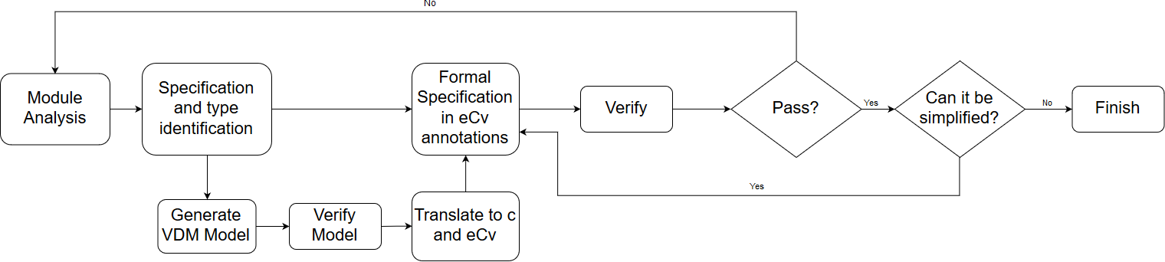
Design Verification: various
Model-based verification languages and tools
CSP/FDR, NuSMV/PVS : risk property model checking
VDM/VSCode, Isabelle : symbolic simulation and proof of specific properties
Code-level verification languages and tools
Dafny/Z3, C/Frama-C : specification discovery
C and C++/eCv : MISRA compliance, auditable correctness proofs
Notes:
Experimenting with which one would be most suitable
eCv: resolution prover that produces correctness proofs; avionics/military domain certified tool

Slide 9
Methodology
Identify / explore adequate formal languages and tools
Model-based formalisms for the design (i.e. FSM + properties)
Code-level verification for C/C++ (partial/total correctness)
Link solutions to regulatory process is crucial
Notified bodies
Early engagement is crucial
Engagement approach inspired by the process pioneered by (Altran-)Praxis
Choices are dependent on
Openness of designers + time availability + when FM use started
Socio technical experiment in convincing experienced engineers in diff. field
Notes:
Okay, will bring my experience from the avionics domain, and formal spec/verific of large systems and it will be grand
How wrong I was: here started the journey to try and identify something that would be suitable + acceptable (not easey)

Slide 10
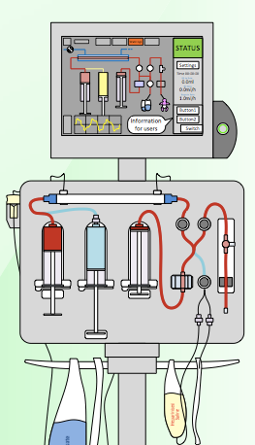
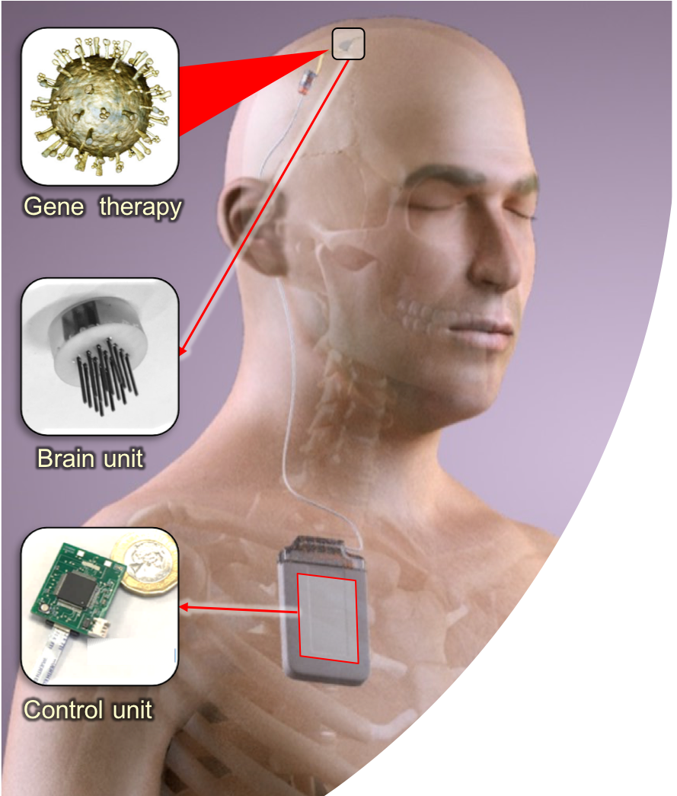
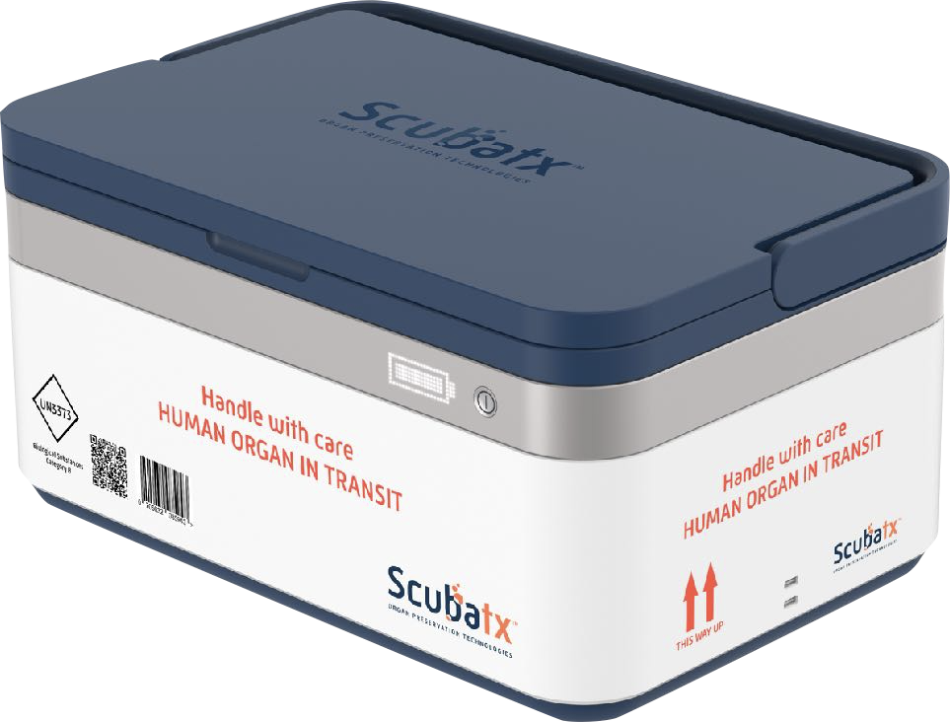
Socio-technical experiments
Infant Dialyser (NHS)
2008 – 2017 (2014)
Brain Pacemaker (EPSRC/CANDO)
2014 – 2022 (2016)
Organ Preservation (ScubaTx)
2018 – 2021 (2017)
Notes:
Late enter
Mid enter
Early enter

Slide 11
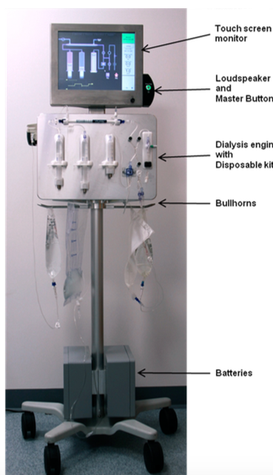
Infant Dialyser (late adoption)
Novel infant hemodialyzer for premature babies (0.8-8kgs)
Prototype manual syringe pumps (2008)
Developed by NHS Regional Medical Physics Department (NICE)
Risk analysis and CE-marking required prior to hand-over (2017)
Collaboration with medical physicists product developers
Our work:
Verification (VDM) FSM state machine controlling dialysis cycle
Verification of C++ implementation of FSM
Notes:
discuss the reason for real need (maybe show the paper): precision + speed + length of circuit
RMPD choose devices and their suitability as well as develop them

Slide 12
What questions were of interest?
Display conditions: alarm inhibited only if the state has a certain attribute (i.e. alarm fatigue x missing alarms)
Relations between state attributes:
Valve can only be in a certain state if dialysing
Motor in one state implies other motor in another
An error event will always lead to an error state relevant
No error events means normal cycles will have certain characteristics
Certain messages must always appear after leaving a particular cycle
Notes:
All checked as VDM invariants in a simulation + MAL/CTL + eCv

Slide 13
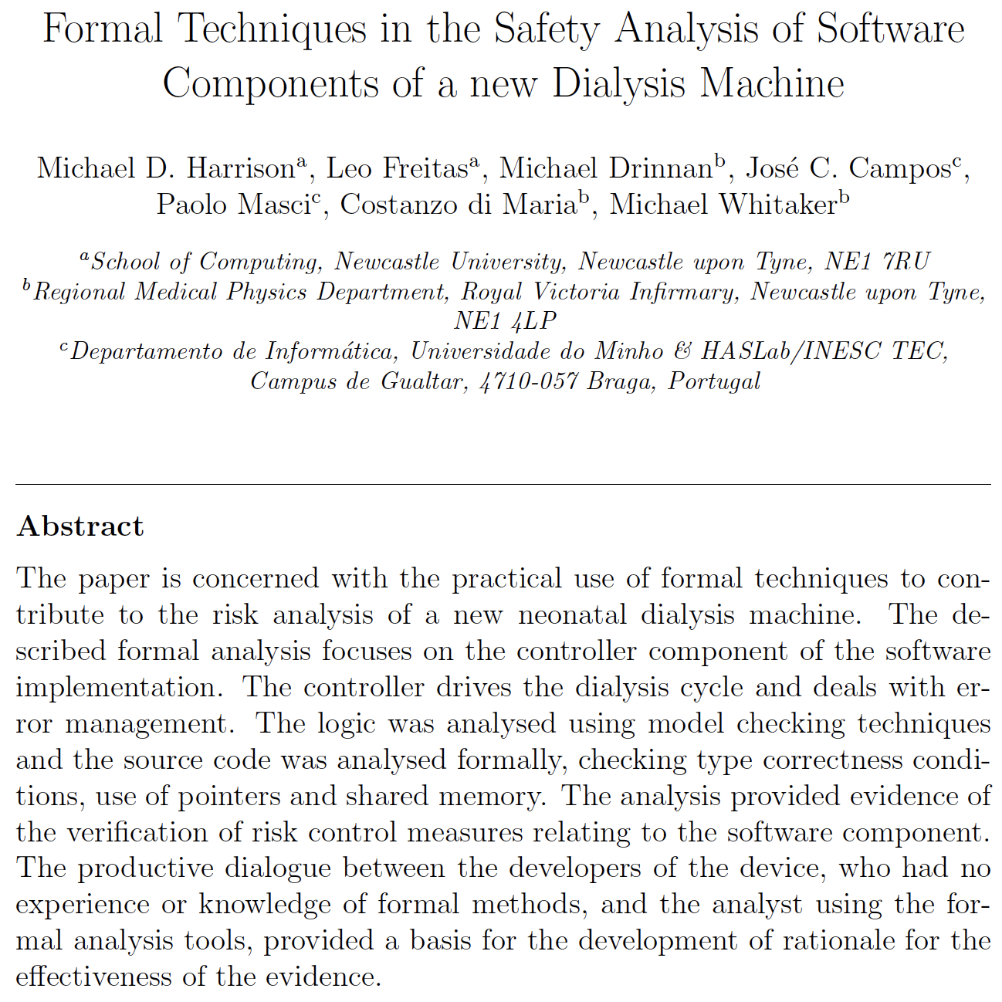
What’s been done?
Work on the design
Model checking against listed risk / hazard profile
Recognised by CE-marking certification purposes
Work on the controller code (Escher Tech. eCv tool)
Experiment with various tools for C++
Achieved MISRA compliance to C/C++ code
Code contracts on most critical parts of C++ controller
~ 5KLOC C/C++; auto-gen VDM + C++ code from FSM
Notes:
Paper: very difficult to publish because…
methods for the design:
Cleanroom + Verum/ASD (e.g. IBM, Philips Medical, Siemens); IVY/MAL/NuSMV
methods for code-level verification:
explain what is MISRA
language subsets (MISRA-like) + memory safety + functional correctness (eCV)
attempted various tools: Verifast, FramaC, VCC, Dafny, etc.
was missing:
methods for requirements + Hazard analysis and risk management (mostly due to my lack of background)
applying MAL + PVS; building MAL front-end tool; CSV-to-MAL/VDM(MH); CSV-to_C; PVS-io-web (todo)

Slide 14
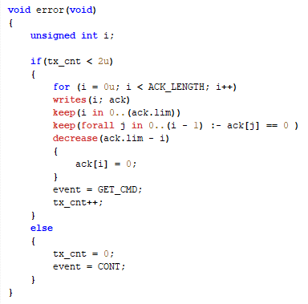
Ex: code verification in Escher C Verifier (eCv)
Verification being carried out using eCv
Design by Contract (code annotations)
Pre and postconditions
Ghost functions
Invariants
Generates verification conditions and passes them to an automatic resolution theorem prover
Checks levels of MISRA compliance

Slide 15
Social technical experiment
How the area works?
Like other safety-critical areas, relies on regulatory process
Data often gathered through expensive clinical trials
Operate under tight schedule and budgets
Software is key to device functionality, yet not priority for deployment
Risk-analysis based process, where risk mitigation is argued with evidence

Slide 16
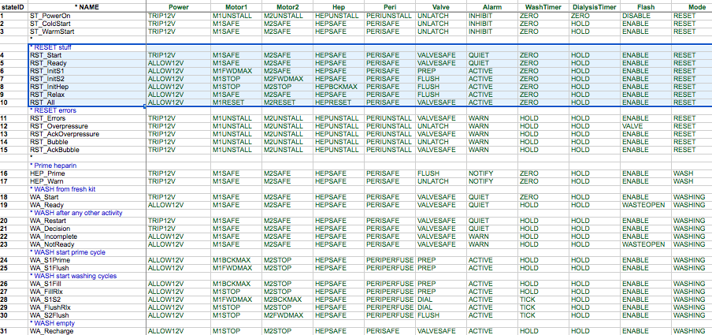
The finite state machine (FSM)
Notes:
123 states
32 events
7 hardware/software messages per cycle

Slide 17
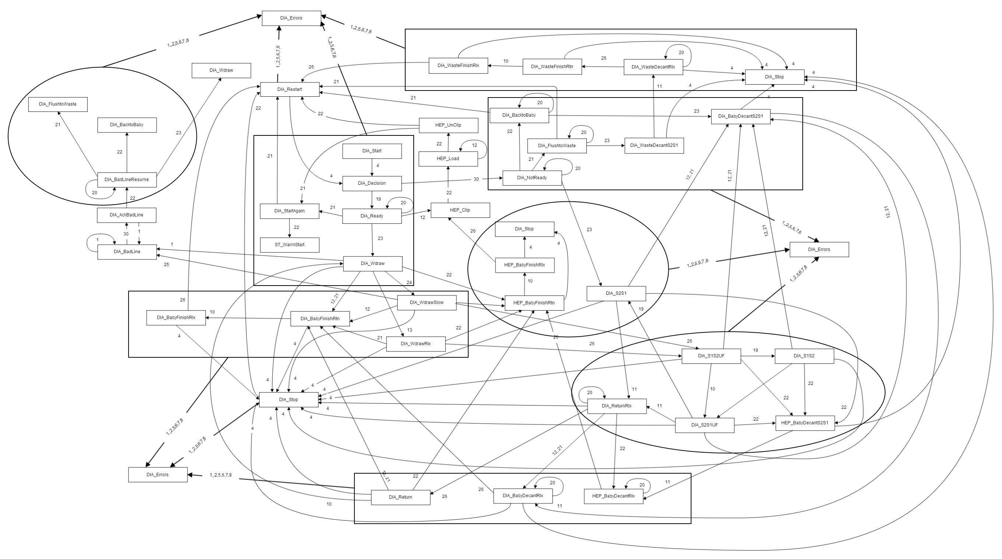
Dialysis cycle FSM
Notes:
a glimpse at the dialyse state - there are 123 in total, many hard-ware detected error conditions
bubble / air detection; line kink; filter (over)pressure limit; power short-circuit (due to failure) etc.

Slide 18
The risk log: controller related properties
For each documented hazard/risk associated with C controller
have a temporal logic formulae checked against its FSM encoding in MAL;
check property with NuSMV and/or PVS

Slide 19
FSM: checks with NuSMV/PVS, VDM+Isa/HOL, eCv
P1: specified states are inaccessible in dangerous circumstances. E.g.: “it should not be possible to dialyse an infant with heparin in the blood circuit”.
P2: when the dialysis machine is error free it always generates a correct dialysis sequence. This sequence includes wash and dialysis stages.
P3: when an error event occurs then the device is taken to an appropriate error state.
P4: states can only be reached if combinations of states have happened in the past. An example of such a property is that relevant reminders are always displayed to “close a clamp before the next phase of the cycle can commence”.
Notes:
Talk about error: 2000 clinical use not observed
Clinical use trials are expensive (e.g. hospital setting)
Tell “debug session” story?

Slide 20
// Hardware message: varied clocks leads to required decision below
inline int BolousOfEncoder( int MSB, int LSB )
{
// MSB and LSB share 3 bits, moved to Moverlap and Loverlap
int Moverlap = MSB & 0x07 ;
int Loverlap = ( LSB / 32 ) & 0x07 ;
// We believe LSB, so correct the MSB if they are different
int DeltaOverlap = ( Loverlap - Moverlap ) & 0x07 ;
int TrueMSB = MSB + DeltaOverlap ;
if( DeltaOverlap & 0x04 ) TrueMSB -= 0x08 ;
// -8 to compensate for encoder zero offset to prevent firmware overflow
return ( ( TrueMSB * 32 ) | LSB ) - 8 ;
}
Notes:
Where’s wally?
MISRA Compliance tell you a number of things

Slide 21
// Hardware message: varied clocks leads to required decision below
inline unsigned int BolousOfEncoder(unsigned int MSB, unsigned int LSB )
pre( MSB >= 0 && LSB >= 0 && MSB <= 255 && LSB <= 255 )
{
// MSB and LSB share 3 bits, moved to Moverlap and Loverlap
unsigned int Moverlap = MSB & 0x07u ;
unsigned int Loverlap = ( LSB / 32 ) & 0x07u ;
// We believe LSB, so correct the MSB if they are different
unsigned int DeltaOverlap = ( Loverlap - Moverlap ) & 0x07u ;
unsigned int TrueMSB = MSB + DeltaOverlap ;
if( DeltaOverlap & 0x04u ) TrueMSB -= 0x08u ;
// -8 to compensate for encoder zero offset to prevent firmware overflow
return ( ( TrueMSB * 32 ) | LSB ) - 8 ;
}

Slide 22
// Hardware message: varied clocks leads to required decision below
inline unsigned int BolousOfEncoder(unsigned int MSB, unsigned int LSB )
pre((minof(int) <= (63u & msb)) && (minof(int) <= (63u & (lsb / 4u))) && (((63u & (lsb / 4u)) < (256u + (63u & msb))) && ((63u & msb) <= (63u & (lsb / 4u)))) && ( minof(int) <= (63u & ( (63u & (lsb/ 4u)) - (63u & msb) )) ) && (minof(int) <= ((63u & ( (63u & (lsb / 4u)) - (63u & msb))) + msb)) && ( ((63U & ((63U & (LSB / 4U)) - (63U & MSB))) + (63U & MSB)) in minof(int)..(maxof(int)-1) ) )
{ // MSB and LSB share 3 bits, moved to Moverlap and Loverlap
unsigned int Moverlap = MSB & 0x07u ;
unsigned int Loverlap = ( LSB / 32 ) & 0x07u ;
// We believe LSB, so correct the MSB if they are different
unsigned int DeltaOverlap = ( Loverlap - Moverlap ) & 0x07u ;
unsigned int TrueMSB = MSB + DeltaOverlap ;
if( DeltaOverlap & 0x04u ) TrueMSB -= 0x08u ;
// -8 to compensate for encoder zero offset to prevent firmware overflow
return ( ( TrueMSB * 32 ) | LSB ) - 8 ;
}

Slide 23
// Hardware message: varied clocks leads to required decision below
typedef unsigned int /*char*/ invariant(value in 0..(UINT8_MAX)) Byte;
inline Byte BolousUpOfEncoder( Byte MSB, Byte LSB )
pre( ( (((7U & ((7U & (LSB / 32U)) - (7U & MSB))) + MSB) < 256 ) ) )
post( result in 0..((1 << 13)-1) )
{
// MSB and LSB share 3 bits, moved to Moverlap and Loverlap
Byte Moverlap = MSB & 0x07u ;
Byte Loverlap = ( LSB / 32u ) & 0x07u ;
if (Loverlap >= Moverlap) { … } else { … };
assert( TrueMSB in 0..(maxof(Byte)+0x04u) );
... Bit more involved code
// -8 to compensate for encoder zero offset to prevent firmware overflow
return ( ( TrueMSB * 32 ) | LSB ) - 8 ;
}

Slide 24
// Hardware message: varied clocks leads to required decision below
typedef unsigned int /*char*/ invariant(value in 0..(UINT8_MAX)) Byte;
inline Byte BolousUpOfEncoder( Byte MSB, Byte LSB )
pre( curbedLSB(LSB) - curbedMSB(MSB) in -4..3 )
post( result in 0..((1 << 13)-1) )
{
// MSB and LSB share 3 bits, moved to Moverlap and Loverlap
Byte Moverlap = MSB & 0x07u ;
Byte Loverlap = ( LSB / 32u ) & 0x07u ;
if (Loverlap >= Moverlap) { … } else { … };
assert( TrueMSB in 0..(maxof(Byte)+0x04u) );
... Bit more involved code
// -8 to compensate for encoder zero offset to prevent firmware overflow
return ( ( TrueMSB * 32 ) | LSB ) - 8 ;
}

Slide 25
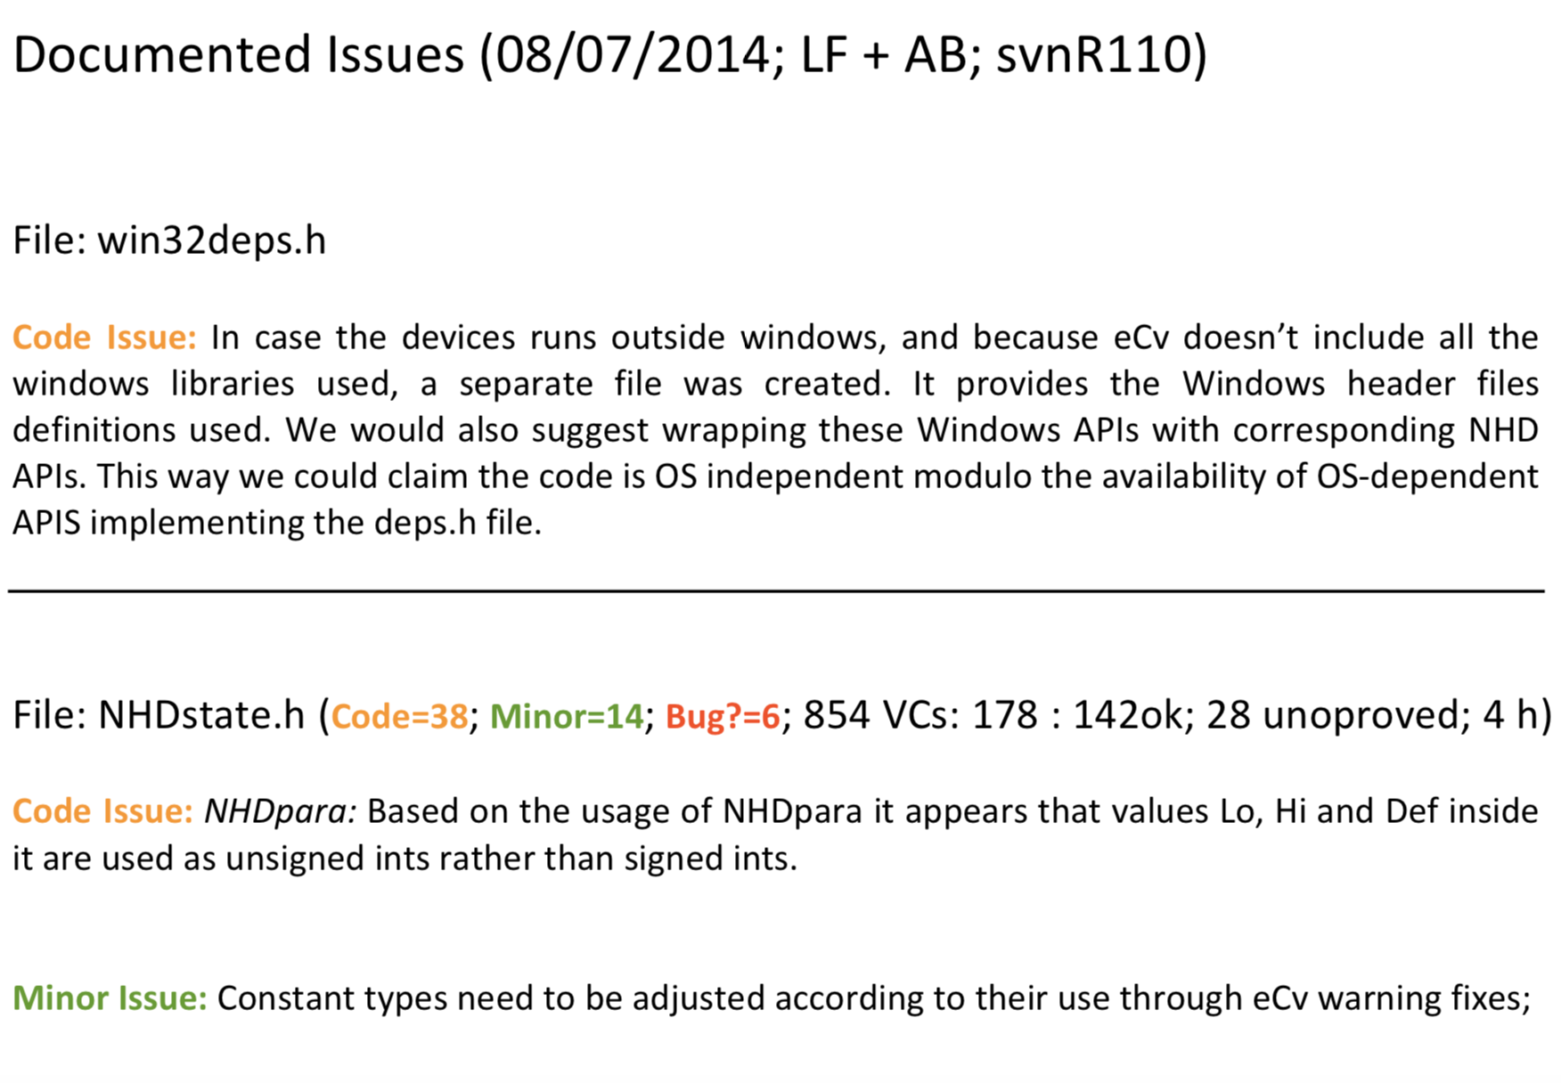
Packet Construction
Controller behaves as two queues of events/commands
One queue HW puts its messages
Another controller sends its requests
Different clocks lead to multiple reads
At the centre of every event condition decision were ``dialysis functions”
Low-level C code adjusting read data for clock variations
Lead to overlapping of 3 data bits to be decided by an algorithm
Communication packet – 13 bits
Address:
3 bits
Command:
3 bits
Data:
7 bits
LSB 3b
MSB

Slide 26
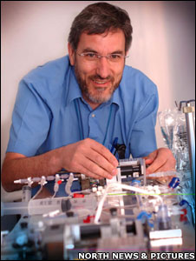
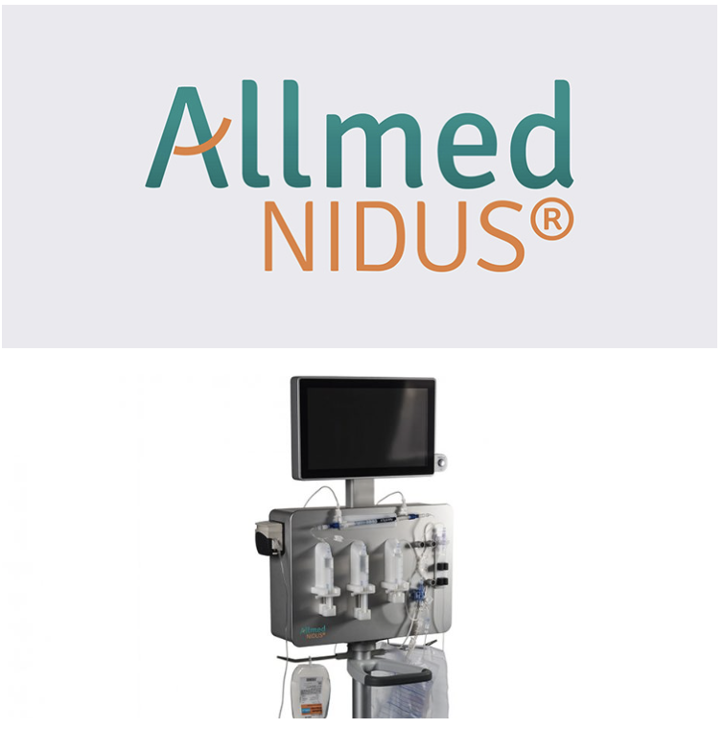
Timeline
Inception
(2008)
Design
(2008-2015)
Implementation
(2013-2017)
Commercialisation (2018)
Notes:
Late enter
Mid enter
Early enter

Slide 27
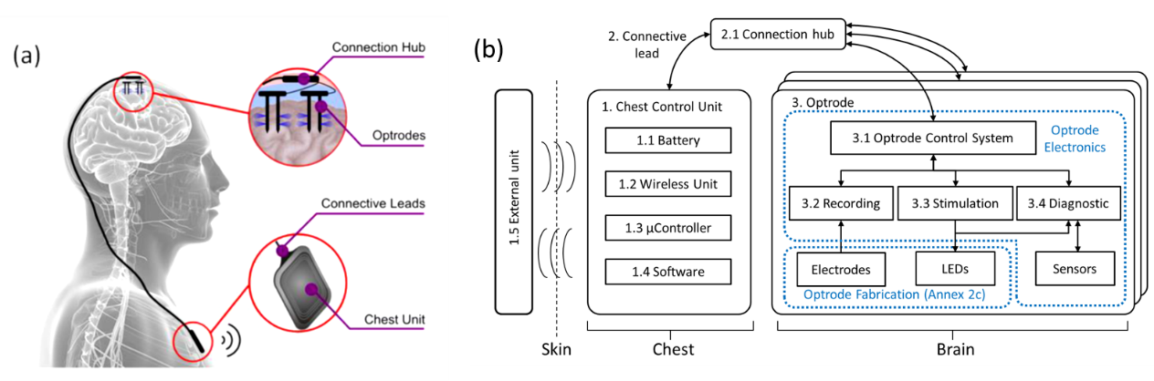
Brain Pacemaker (mid point adoption)
Optogenetic stimulation (i.e. electrical signal input; light signal output)
Embedded software within the controller unit for closed-loop stimulation
External software for wireless download diagnostic information and upload control parameters
Notes:
Light for electrical signal leads to heat; epilepsy x parkinsons
explain the DURA issue (i.e. genetics, materials, medical, control system) (lower priority)
Engineering meetings are fascinating events.
3 levels of control: individual optrode; array; chest unit; time sensitive

Slide 28
What’s been verified?
Verifying the optrode CMOS chip command interface API:
Optrodes communication over SPI (Serial Peripheral Interface)
FSM controlling low-level optrode functionality
FSM design verified in VDM (1KLOC) and Isabelle/HOL (2.5KLOC, 250POs)
FSM control software implemented in C (~3KLOC) for a Freescale chip
Verification boundaries
Not verifying generated device-driver code (~5KLOC)
Not verifying dependant libraries for printed hardware (~110KLOC)

Slide 29
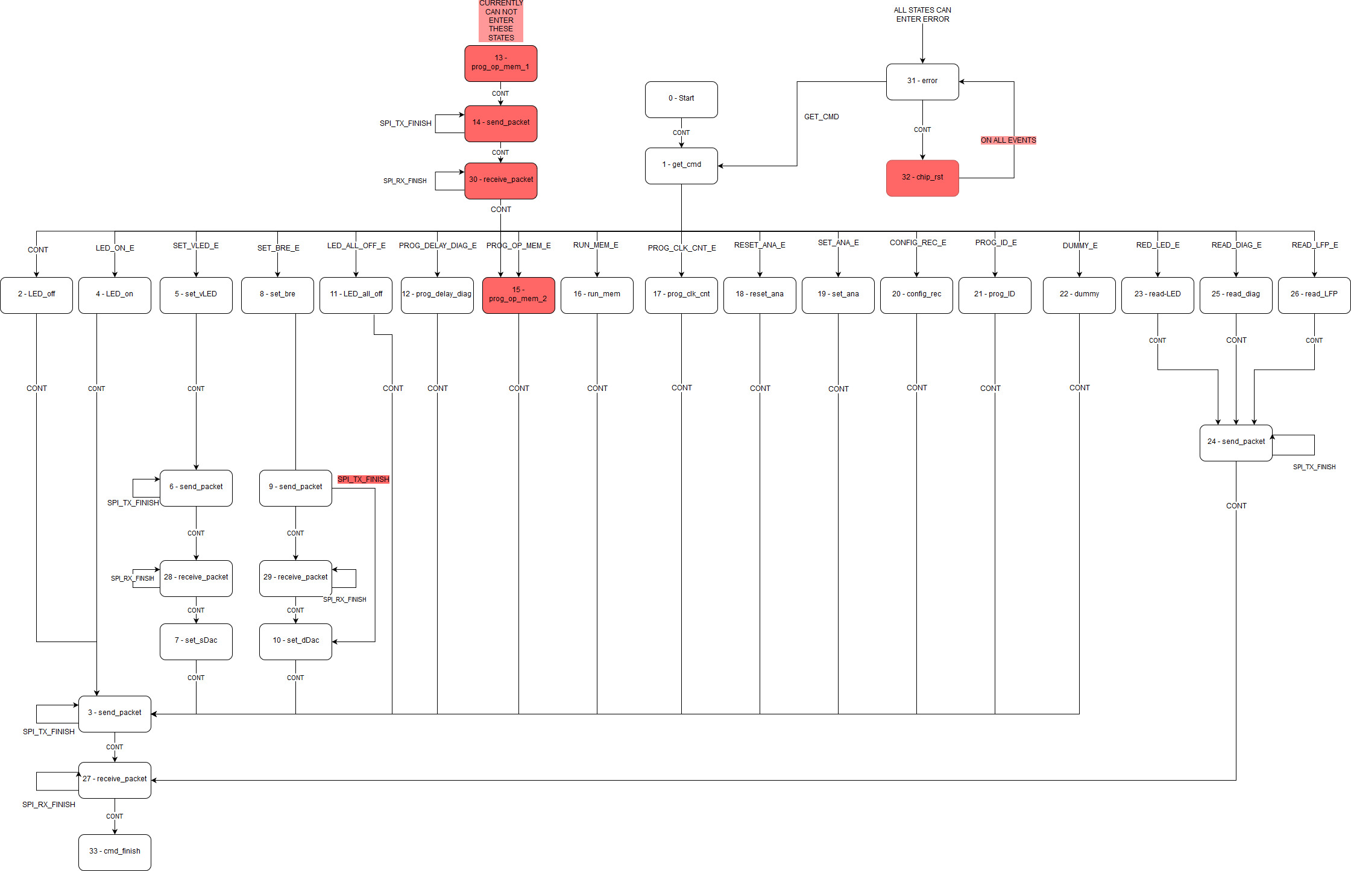
FSM Visualisation
Notes:
Copy + Paste and incompletion (errors)
From looking at the FSM invariants of operation were identified.
Identified unreachable states in the table and incorrect transitions
Examples of identified invariants:
Send and receive states must transition to themselves on transmission finish events – ensure all bytes of the packets are processed
Packet creation states must go to a send state on a continue event – if they don’t the packet can be overwritten by another packet creation state.
Receive packet states must go to command finished or a stage 2 packet creation state – command is either finished or a new packet must be created
Simulated system satisfied these invariants

Slide 30
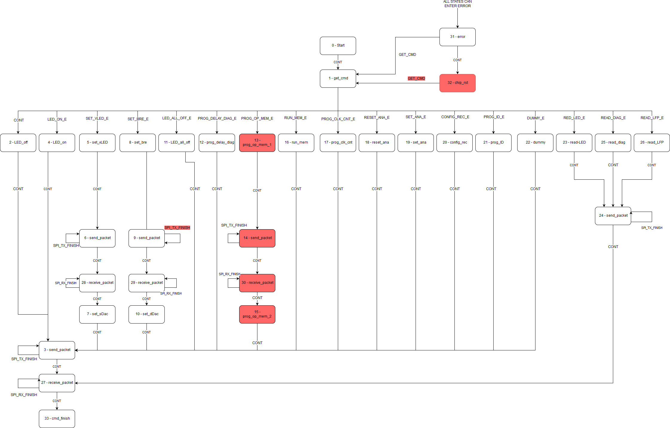
Updated FSM after POs

Slide 31
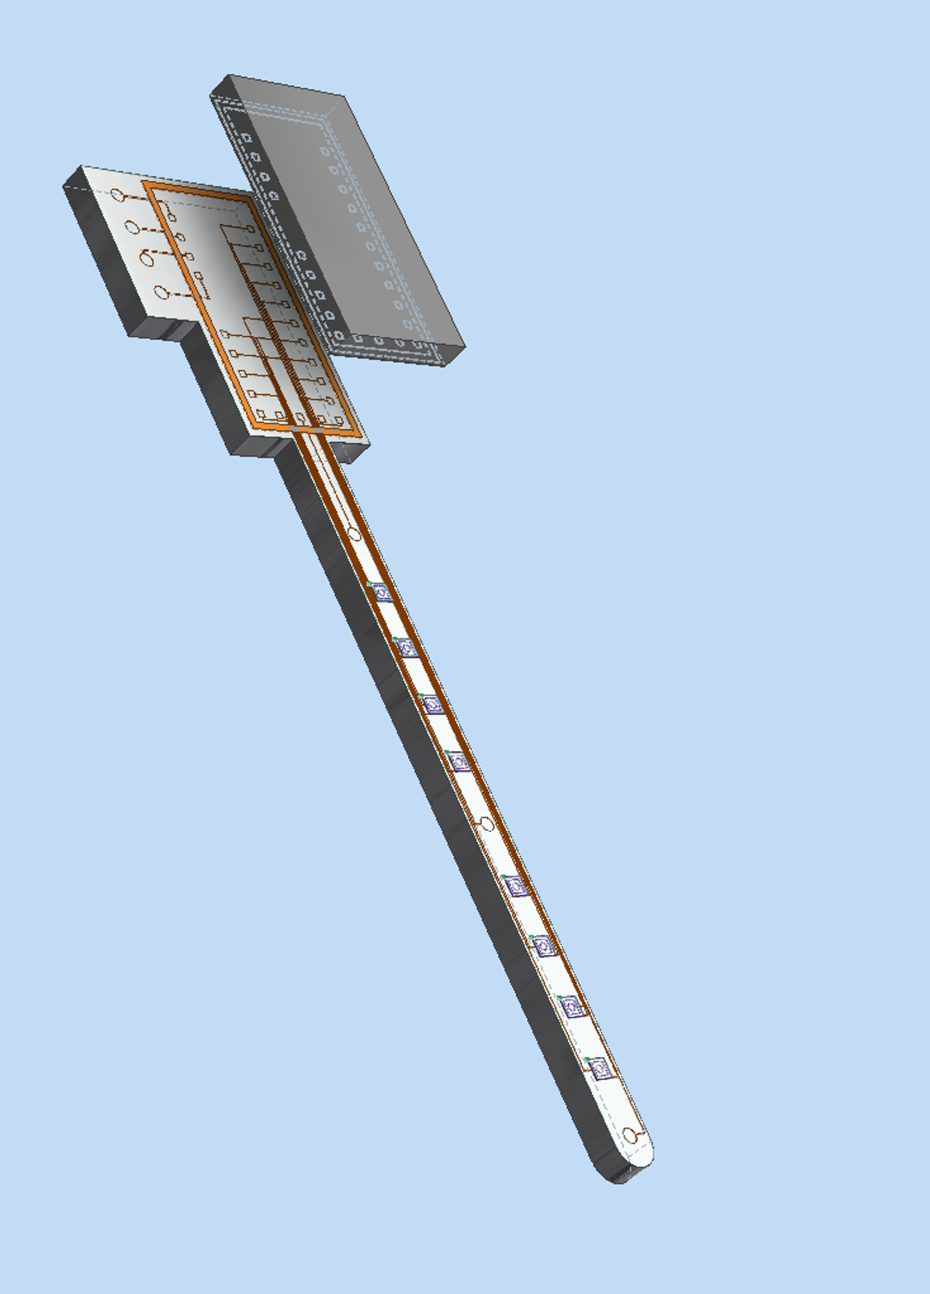
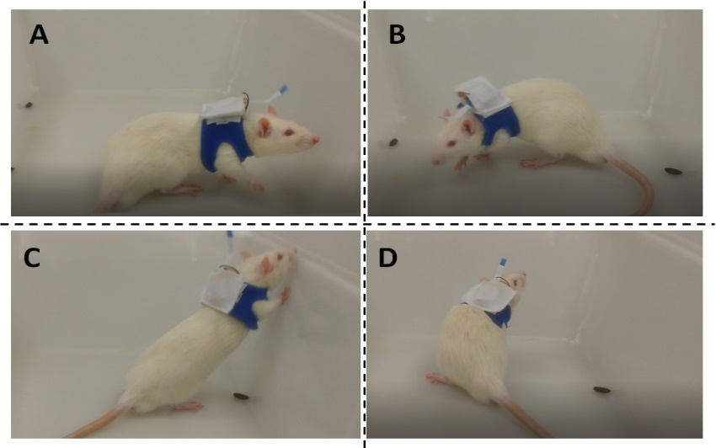
Timeline
Inception
(2014-2015)
Design
(2014-2018)
Rodent Trials
(2017-2018)
Primate Trials
(2019)
Human Trials
(2020)
Notes:
Late enter
Mid enter
Early enter

Slide 32
Organ preservation machine (early adoption)
University spin out - ScubaTx https://www.scubatx.com
HUBCap project with industry leader DRis-Q
Organ preservation machine for multiple organs (e.g. heart, liver, kidney, pancreas, etc.) with initial focus on pancreas
400M diabetes patients worldwide, 10% Type 1
NHS 2017 budget £122B, £9.8B (~10%) for diabetes
Type 1 diabetes accounts for 11% patient pool
1-5% of these patients cannot be managed traditionally
Islet transplantation:
Minimally invasive
Avoids high morbidity or mortality
It’s costly (£25K/treatment; 3 per patient on average)

Slide 33
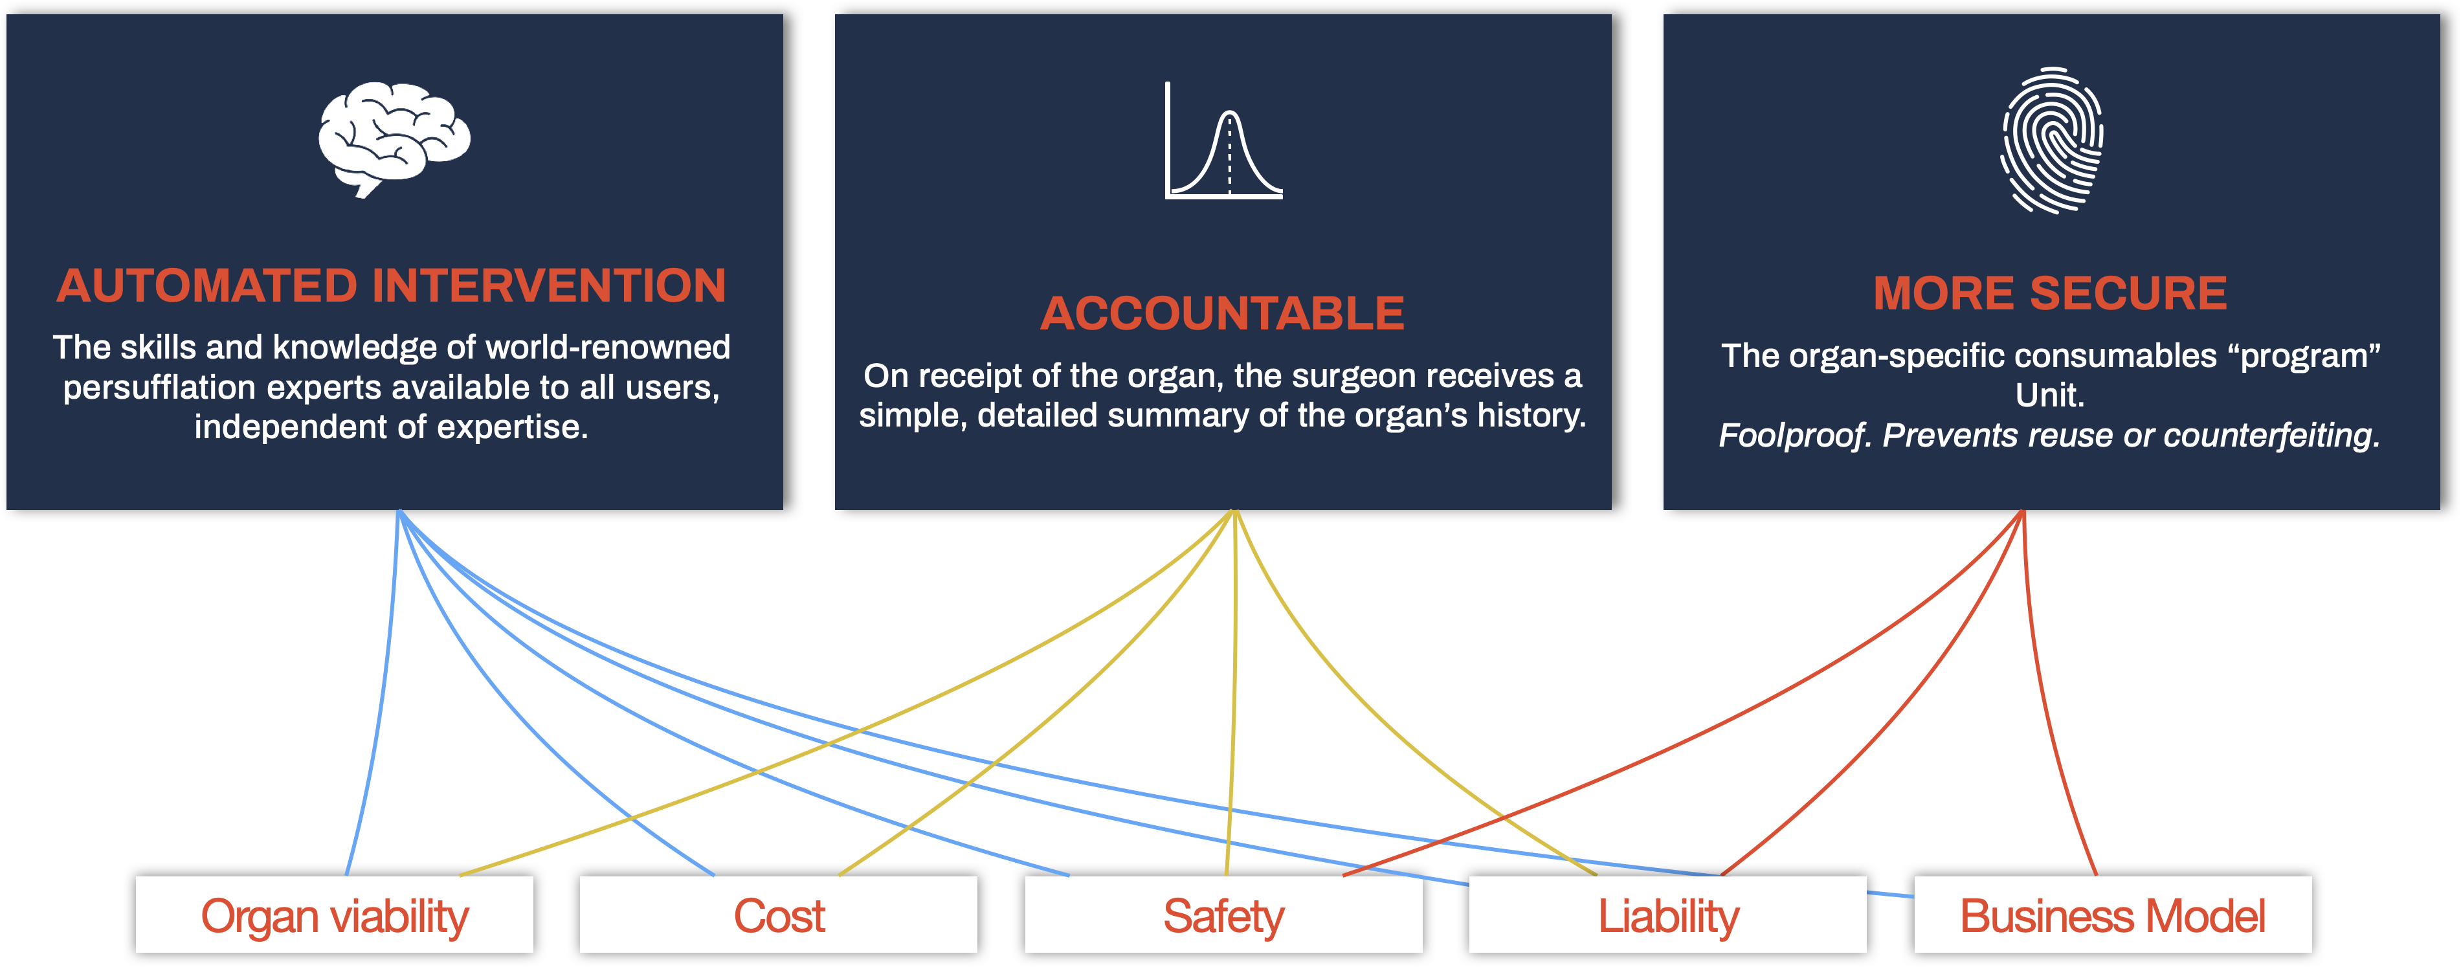
Notes:
Automation – Simplifying use and avoiding additional specialist personnel in the theatre and during transport (e.g. algorithm)
Portability – Easily loaded from various forms of transport and moved around hospitals while in operation
Flexibility – One base-unit can be applied to most organ/tissue applications enabling economy of scale as further applications demonstrate benefit and minimising storage requirements for hospitals with multiple uses
Effective integration – Size and layout are specifically tailored to optimise theatre space during use
Remote monitoring – Enabling user-monitoring at all times
Cost effectiveness – Providing healthcare providers value-for-money

Slide 34
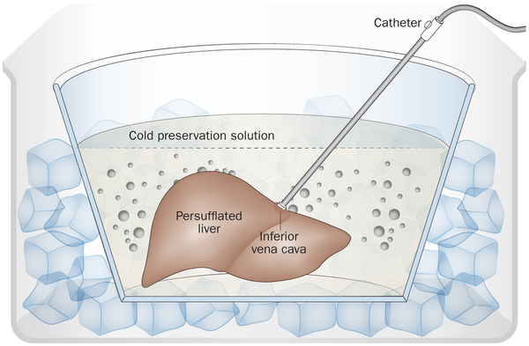
Organ preservation machine (early adoption)
Recently got (small) funding for parts; going for £££ in 2019
Automation – Simplifying use and avoiding additional specialist personnel in the theatre and during transport (e.g. algorithm)
Portability – Easily loaded from various forms of transport and moved around hospitals while in operation
Flexibility – One base-unit can be applied to most organ/tissue applications enabling economy of scale as further applications demonstrate benefit and minimising storage requirements for hospitals with multiple uses
Effective integration – Size and layout are specifically tailored to optimise theatre space during use
Remote monitoring – Enabling user-monitoring at all times
Cost effectiveness – Providing healthcare providers value-for-money
Notes:
discuss the reason for real need (maybe show the paper):
400M diabetes, 10% Diabetes Type1; 10B£
2017 NHS Annual budget 122B£, ~10% (10B£ diabetes); to read 17B in 2035;
Type-1 diabetes (T1D) accounts for 12% of this patient-pool and 1-5% T1D patients cannot be managed traditionally,

Slide 35
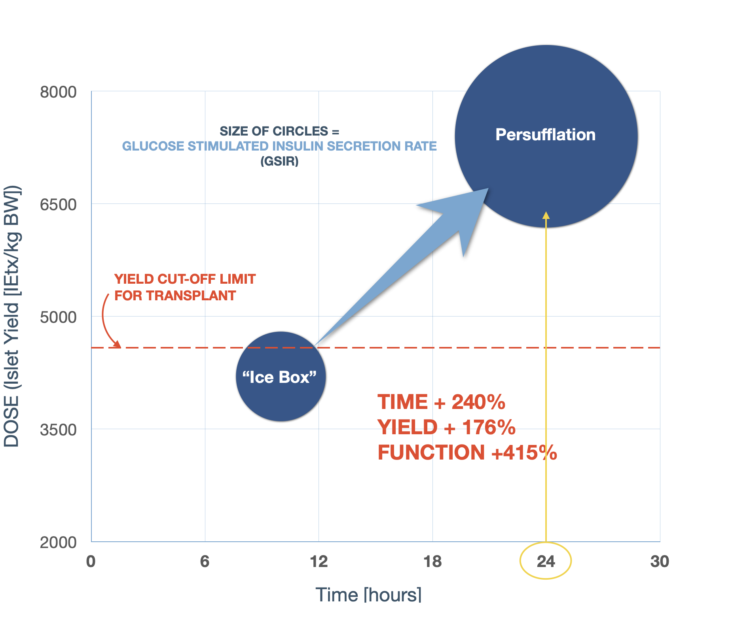
Organ preservation machine
Improved transplant outcomes (from 3 to 1-2 pancreas per patient)
Improved organ-function quality (e.g. 76% increased Islet yield)
Improved longevity of organ viability (e.g. from 4 to 24hrs)
Earlier prototype using off-shelf components
Analysis and implementation of the preservation algorithm
Analysis and definition of adequate notions of alarms
Filled five UK/EU patents on design and algorithm
Notes:
discuss the reason for real need (maybe show the paper): precision + speed + length of circuit

Slide 36


Slide 37
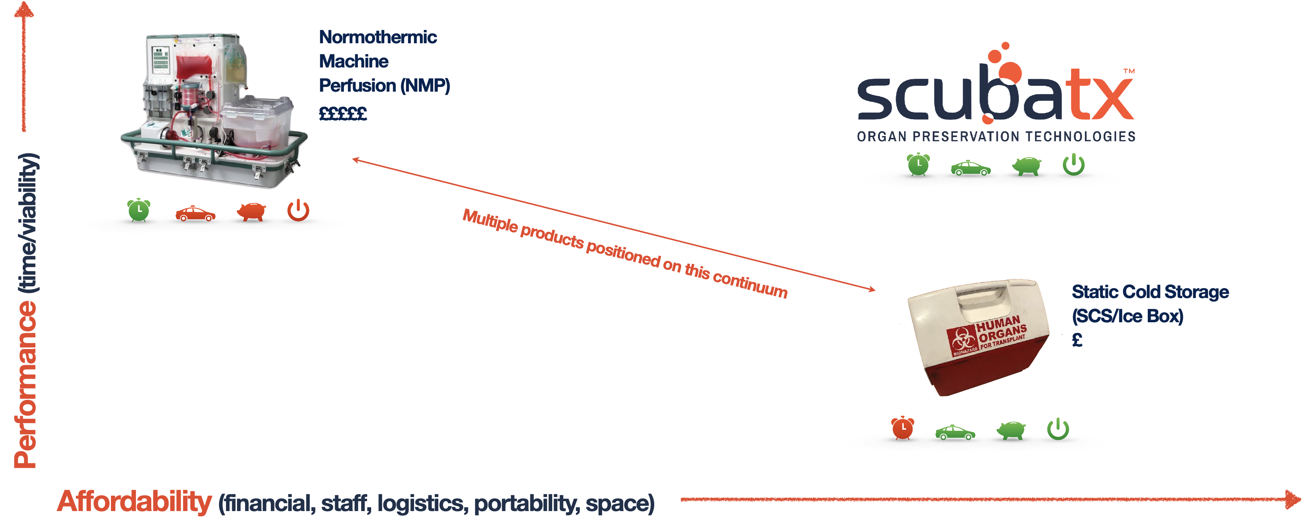
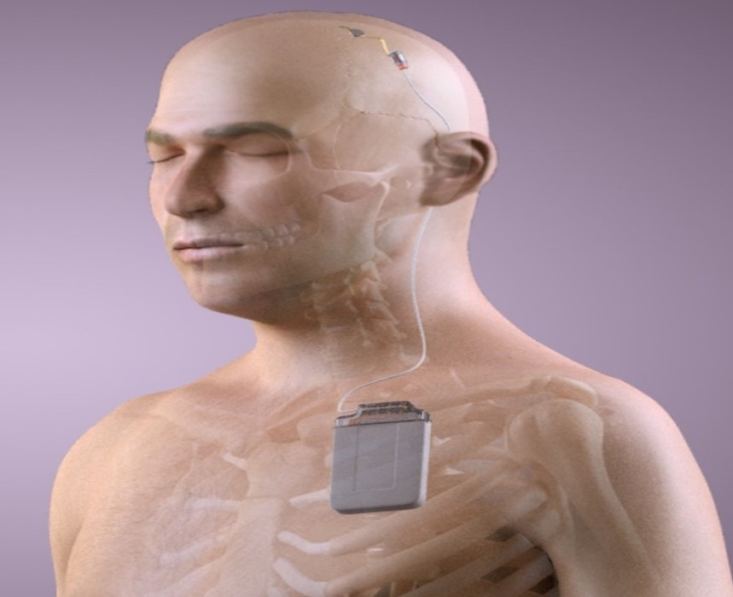
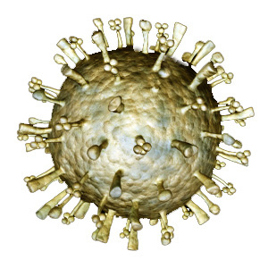
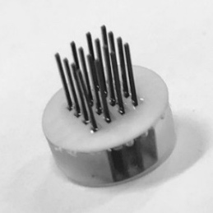
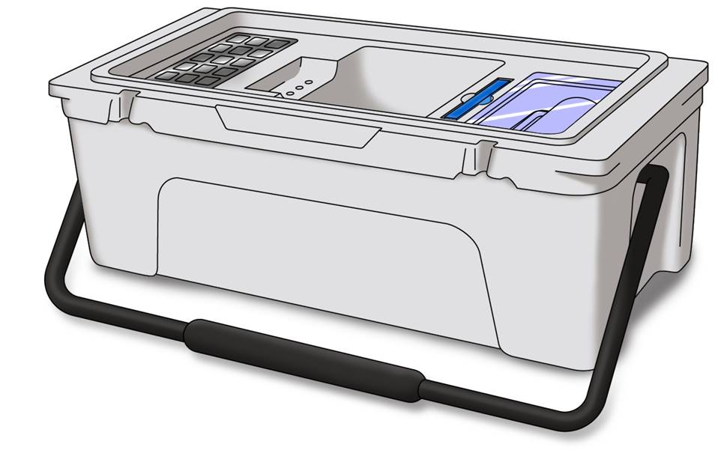
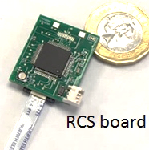
Commercial landscape
Gene therapy
Gene therapy
Brain unit
Brain unit
Control unit
Control unit
Notes:
Mention of / for Maciej about “price of innovation”

Slide 38

Timeline
Inception
(2017-2018)
Design
(2018-2020)
Implementation + Trials
(2018-2020)
Certification
(2020-2021)
Notes:
Late enter
Mid enter
Early enter

Slide 39
Conclusion
Need to be careful not to be lost in translation
Model-based formalisms for the design (i.e. FSM + properties)
Code-level verification for C/C++ (partial/total correctness)
Link solutions to regulatory process is crucial
Socio technical experiments
Early adoption is more beneficial
Important to have regulator/notified body on-side
Our goal
Understand and influence/improve medical device development processes

Slide 40
What else?
VDM Toolkit (https://github.com/leouk/VDM_Toolkit )
Experiments: ML-styled theorem prover, COOL, Games, Verifier, Games, etc.
Libraries: Binary, Matrix, Support, Fuzzy Sets, ISQ, Relations,
Plugins: VDM to Isabelle/HOL + VDM proof strategies
Annotations: Witness, Time
Specification Graphical Animations
~31KLOC VDM, ~15KLOC Isabelle/HOL, ~5KLOC Java
Gene therapy
Gene therapy
Brain unit
Brain unit
Control unit
Control unit
Notes:
Mention of / for Maciej about “price of innovation”

Slide 41
Dependable Medical Devices
– there is no royal road
Leo Freitas
OVT19, 22/10/2021, Aarhus
Brain Pacemaker Extra

Slide 42
Finite State Machine (FSM) Analysis
From looking at the FSM invariants of operation were identified.
Identified unreachable states in the table and incorrect transitions
Examples of identified invariants:
Send and receive states must transition to themselves on transmission finish events – ensure all bytes of the packets are processed
Packet creation states must go to a send state on a continue event – if they don’t the packet can be overwritten by another packet creation state.
Receive packet states must go to command finished or a stage 2 packet creation state – command is either finished or a new packet must be created
Simulated system satisfied these invariants
Notes:
Used VDM to abstract the details; keeping up with C fiddlyness wasn’t fun, hence VDM

Slide 43
FSM Verification
Modelled the FSM transition table and its invariants
Abstracted away from the C implementation details
Simpler invariants not as fiddley as in C code annotations
Translated back to eCv annotations to verify the C code
Modelling done in VDM
Symbolic simulation, test coverage, code generation
Implemented optrode CMOS chip command-set APIs
Model can simulate executions of the FSM loop
Independent of hardware, which is fiddly and hard to debug

Slide 44
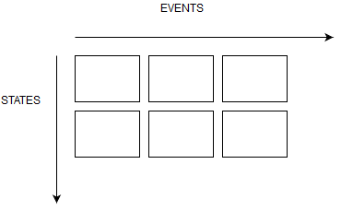
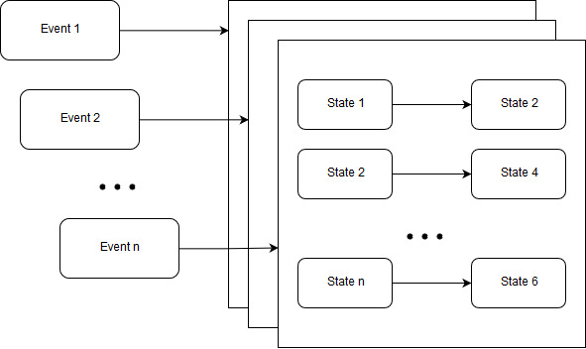
FSM VDM Model
Original transition table as a 2D array
Look up done using current event and state to give the state to transition to
Modelled as a map of event to a map of state to state
StateMap = Map of state -> state
FSM = Map of event -> StateMap
Invariants applied to types to enforce underlying rules as invariants
Notes:
Modelling the FSM transition table and its invariants / embedded information
Abstracted away from the c implementation removing implementation details, not as fiddley as doing it straight in c annotations
Translated to eCv annotations to verify the c code

Slide 45
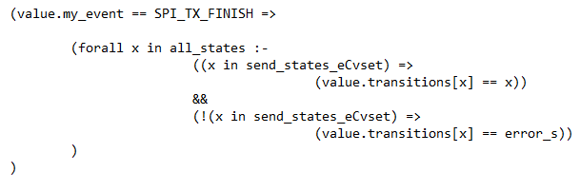
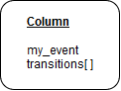
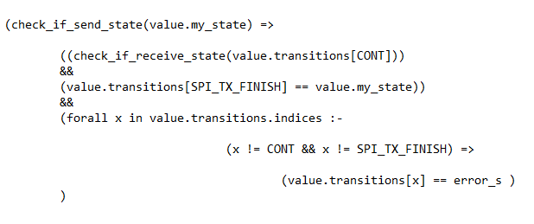
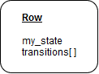
C FSM Implementation/Verification
Verifying the FSM from C (2 versions):
Column struct
invariants in terms of events
event -> (state -> state)
Row struct
invariants in terms of states
state -> (event -> state)
FSM Table is then constructed as an array of columns or rows
Notes:
Isn’t a map data type in c – so used structs that stored either
the event and the transitions for states
The state and the transitions for events

Slide 46
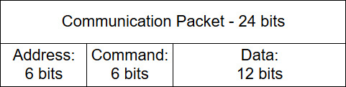
Packet Construction
Several progressive iterations and steps to discharge VCs:
Remove errors produced during verification
Discharge further verification conditions
Simplify the verification process
Original package assembly contained it’s own bit-vector expression
Packet = ((((addr & BITS_6) << 18) | ((cmd & BITS_6) << 12) | (data & MASK)) & BITS_24);

Slide 47
// Hardware instruction: binary package construction
inline packet_t assemble_packet(const bits_6_t addr, const bits_6_t cmd, const bits_12_t data) ghost(const packet_data_t data_length_ghost)
pre (range_check(DATA_LOW, data_length_ghost, data))
post( result == (((addr << ADDR_SHIFT) | (cmd << CMD_SHIFT) | data ) & BITS_24))
{
unsigned long packet_assembly =
(assemble_packet_addr(addr) | assemble_packet_cmd(cmd) | assemble_packet_data(data) ghost(data_length_ghost));
return (packet_t) (packet_assembly & BITS_24);
}
inline packet_t assemble_packet_addr(const bits_6_t addr) const
pre (range_check(ADDR_LOW, ADDR_HIGH, (addr << ADDR_SHIFT)))
post (range_check(ADDR_LOW, ADDR_HIGH, result))
post(result == old addr << ADDR_SHIFT)
{ return ((packet_t)addr << ADDR_SHIFT); }
Led to reduction from 64 to 8 VCs per packet construction
Verification effort decrease (e.g. 6KVCs to 460VCs)
Less VCs due to lesser up/down casts

